Slide 1
Attendance Tracking Web-Application (Using Facial Recognition)
Supervisor
Dr. K Hima Bindu
Team Members
Harshith Suda(423135)
Vanamala Aravind(423188)

Slide 2
PROBLEM STATEMENT
Time is a valuable resource for everyone, especially in educational institutions where professors, teachers, and technicians must allocate it wisely. However, a significant portion of their time is consumed by the mundane and repetitive task of taking attendance, particularly in classrooms with large student strengths. This process not only disrupts the flow of lectures but also reduces the time available for engaging discussions, conceptual learning, and problem-solving.

Slide 3
EXISTING AND PROPOSED SOLUTIONS
EXISTING SOLUTIONS(for facial recognition)
1. YOLO (You Only Look Once) – Object & Face Detection: Used in security cameras to detect intruders or suspicious movements in real-time. In autonomous cars, it helps with navigation and accident prevention by recognizing objects and pedestrians.(Eg.Current->Library but classroom->tedious to show face after every class)
2. DeepFace & FaceNet – Face Recognition Models: Google uses FaceNet, while Facebook uses DeepFace for facial recognition. However, these models require multiple images per student for better accuracy and are slow. In contrast, OpenCV (face_recognition) is a better choice for our project as it is faster and works with a single facial embedding per student.Facenet works very well with poor lighting conditions and different angles.
PROPOSED SOLUTION
A mobile facial recognition attendance Web-app for colleges that detects students' faces using OpenCV and Dlib, matches them with a database, and records attendance in real-time with local storage and admin authentication.

Slide 4
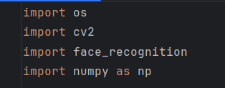
LIBRARIES USED
OS - A built-in Python Module used for interacting with the operating system(e.g., accessing student photos).
CV2(OpenCV) - A computer vision library used for image processing, displaying images, and drawing bounding boxes around faces.
Face Recognition(face_recognition) - A deep learning-based library built on dlib(uses ResNet-34) for face detection and recognition.
Numpy(numpy) - A numerical computing library used for handling face encoding arrays and computing distances between them.

Slide 5
FLOWCHART DEPICTING WORKING OF OPENCV+FACIAL RECOGNITION
STEP-1 – FACE DETECTION
OpenCV uses a combination of two face detection softwares.
HOG (Histogram of Oriented Gradients) + SVM (Support Vector Machine)
Used When:
Low end devices(Raspberry pi)
Limited computational resources
Examples: Detecting Count of Pedestrian on Road
CNN (Convolutional Neural Network)-Based Detector
Used When:
Large datasets and high computational power are available
Detecting complex objects or structures
Examples: Military: Identifying weapons or intruders, Medical: Detecting tumors in scans
Popular CNN-based detectors:
YOLO (You Only Look Once) – Real-time object detection
R-CNN, Fast R-CNN, Faster R-CNN – Trade-off between speed and accuracy

Slide 6
STEP-2-FEATURE EXTRACTION(ENCODING FACE)
The model converts an image into a 128-dimensional embedding using a pre-trained deep learning model from Dlib, based on ResNet-34. These embeddings are numerical representations of unique facial features, enabling efficient and accurate face recognition. To generate these embeddings, Dlib detects 68 facial landmarks, which define key facial structures.
STEP-3-FACE RECOGNITION
The extracted 128-dimensional face encoding is compared with the stored encodings from the initially uploaded photos. The Euclidean distance between them is calculated, and if the distance is below a predefined threshold, the face is recognized as a match, and attendance is marked.

Slide 7
LITERATURE REVIEW
OpenCV (Open Source Computer Vision Library) is a widely used open-source library for real-time computer vision applications. It includes several face recognition algorithms such as Eigenfaces, Fisherfaces, and Local Binary Patterns Histograms (LBPH), which is known for its robustness under varying lighting conditions and low-resolution environments [1]. The LBPH algorithm, originally introduced by Ahonen et al., has been effectively implemented in OpenCV and is particularly suitable for real-time attendance systems [3]. With the integration of deep learning models through OpenCV’s DNN module, modern systems now achieve higher accuracy and improved performance in complex environments [2]. OpenCV's ease of use, cross-platform support, and large community have made it a popular tool in face recognition applications across domains such as security, education, and healthcare.

Slide 8
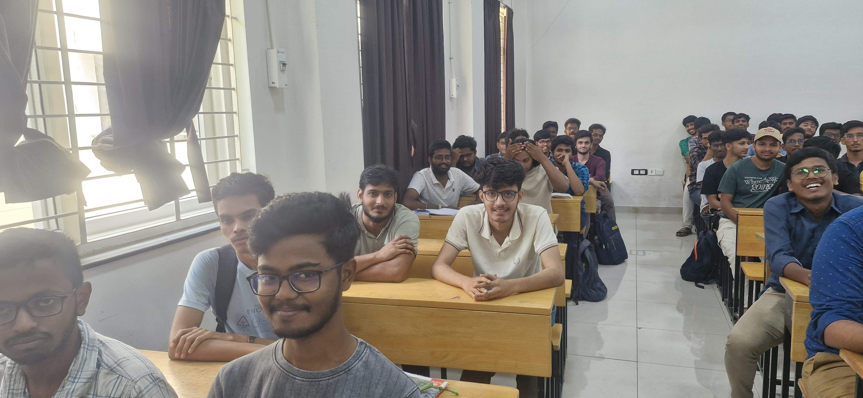
DEMO OF THE SOFTWARE
PHOTO-1
TOTAL STUDENTS IN THE PHOTO - 20

Slide 9
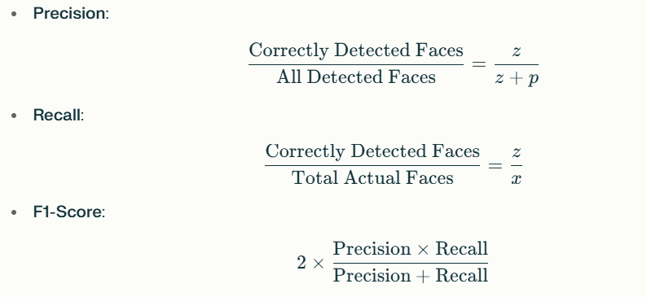
CALCULATION OF METRICS
x :Total students in the photo.
z : Correctly marked students (true positives).
w : Undetected students (false negatives).
p : False positives (incorrect matches).
y : Total students in the database.
DETECTION METRICS(FOR FACE RECOG-BEFORE RECOG)

Slide 10
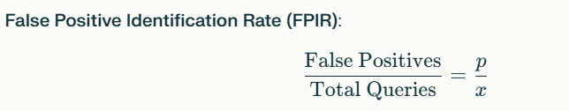

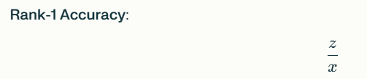
CALCULATION OF METRICS
IDENTIFICATION METRICS
False Negative Identification Rate

Slide 11
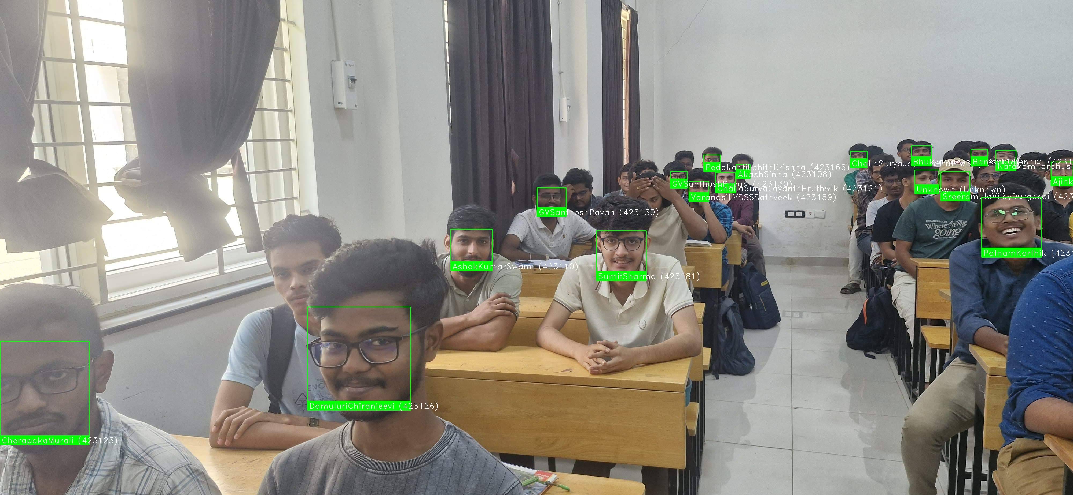
PHOTO-1-RESULT
Precision: 82.35%
Recall: 70.00%
F1-Score: 75.68%
FPIR: 15.00%
FNIR: 15.00%
Rank-1 Accuracy: 70.00%
FMR: 0.3000%
Total Error Rate: 30.00%
Insight :Take photo of 4 benches at a time

Slide 12
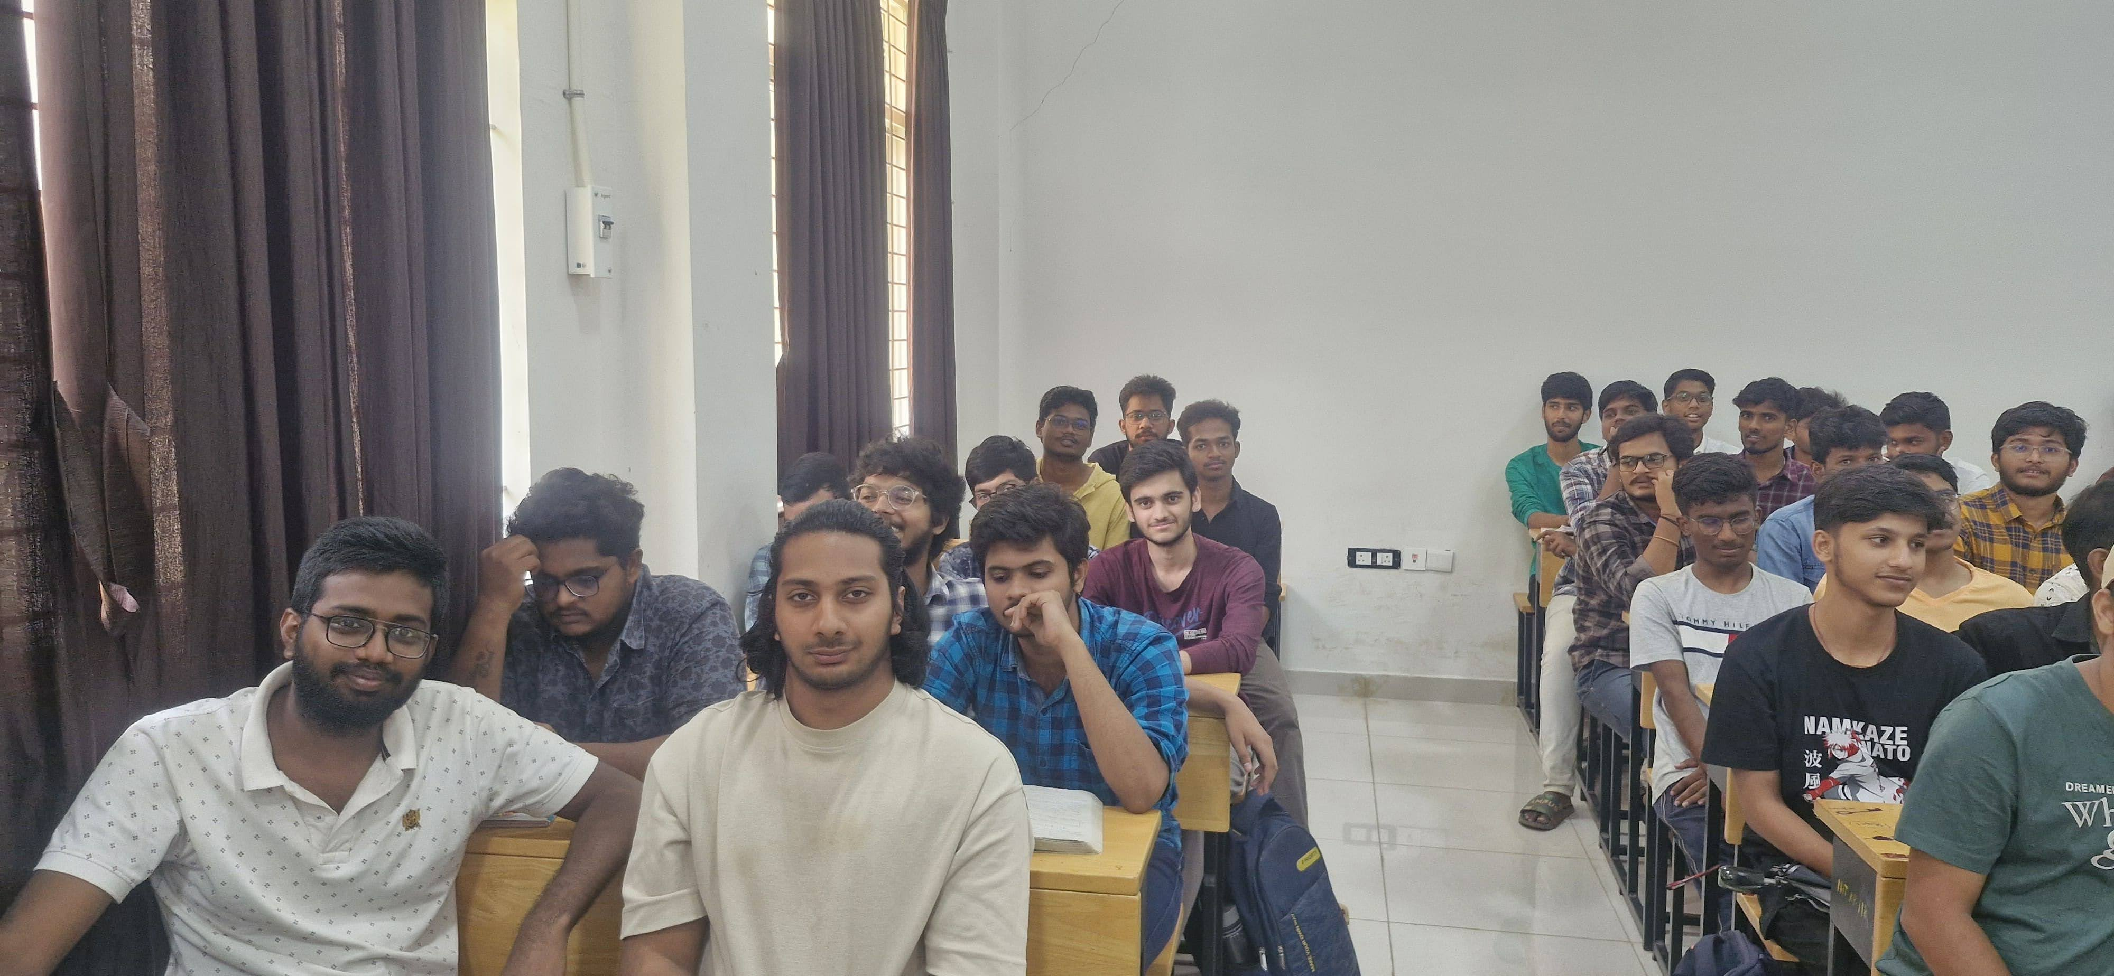
PHOTO-2
TOTAL STUDENTS IN THE PHOTO - 16

Slide 13
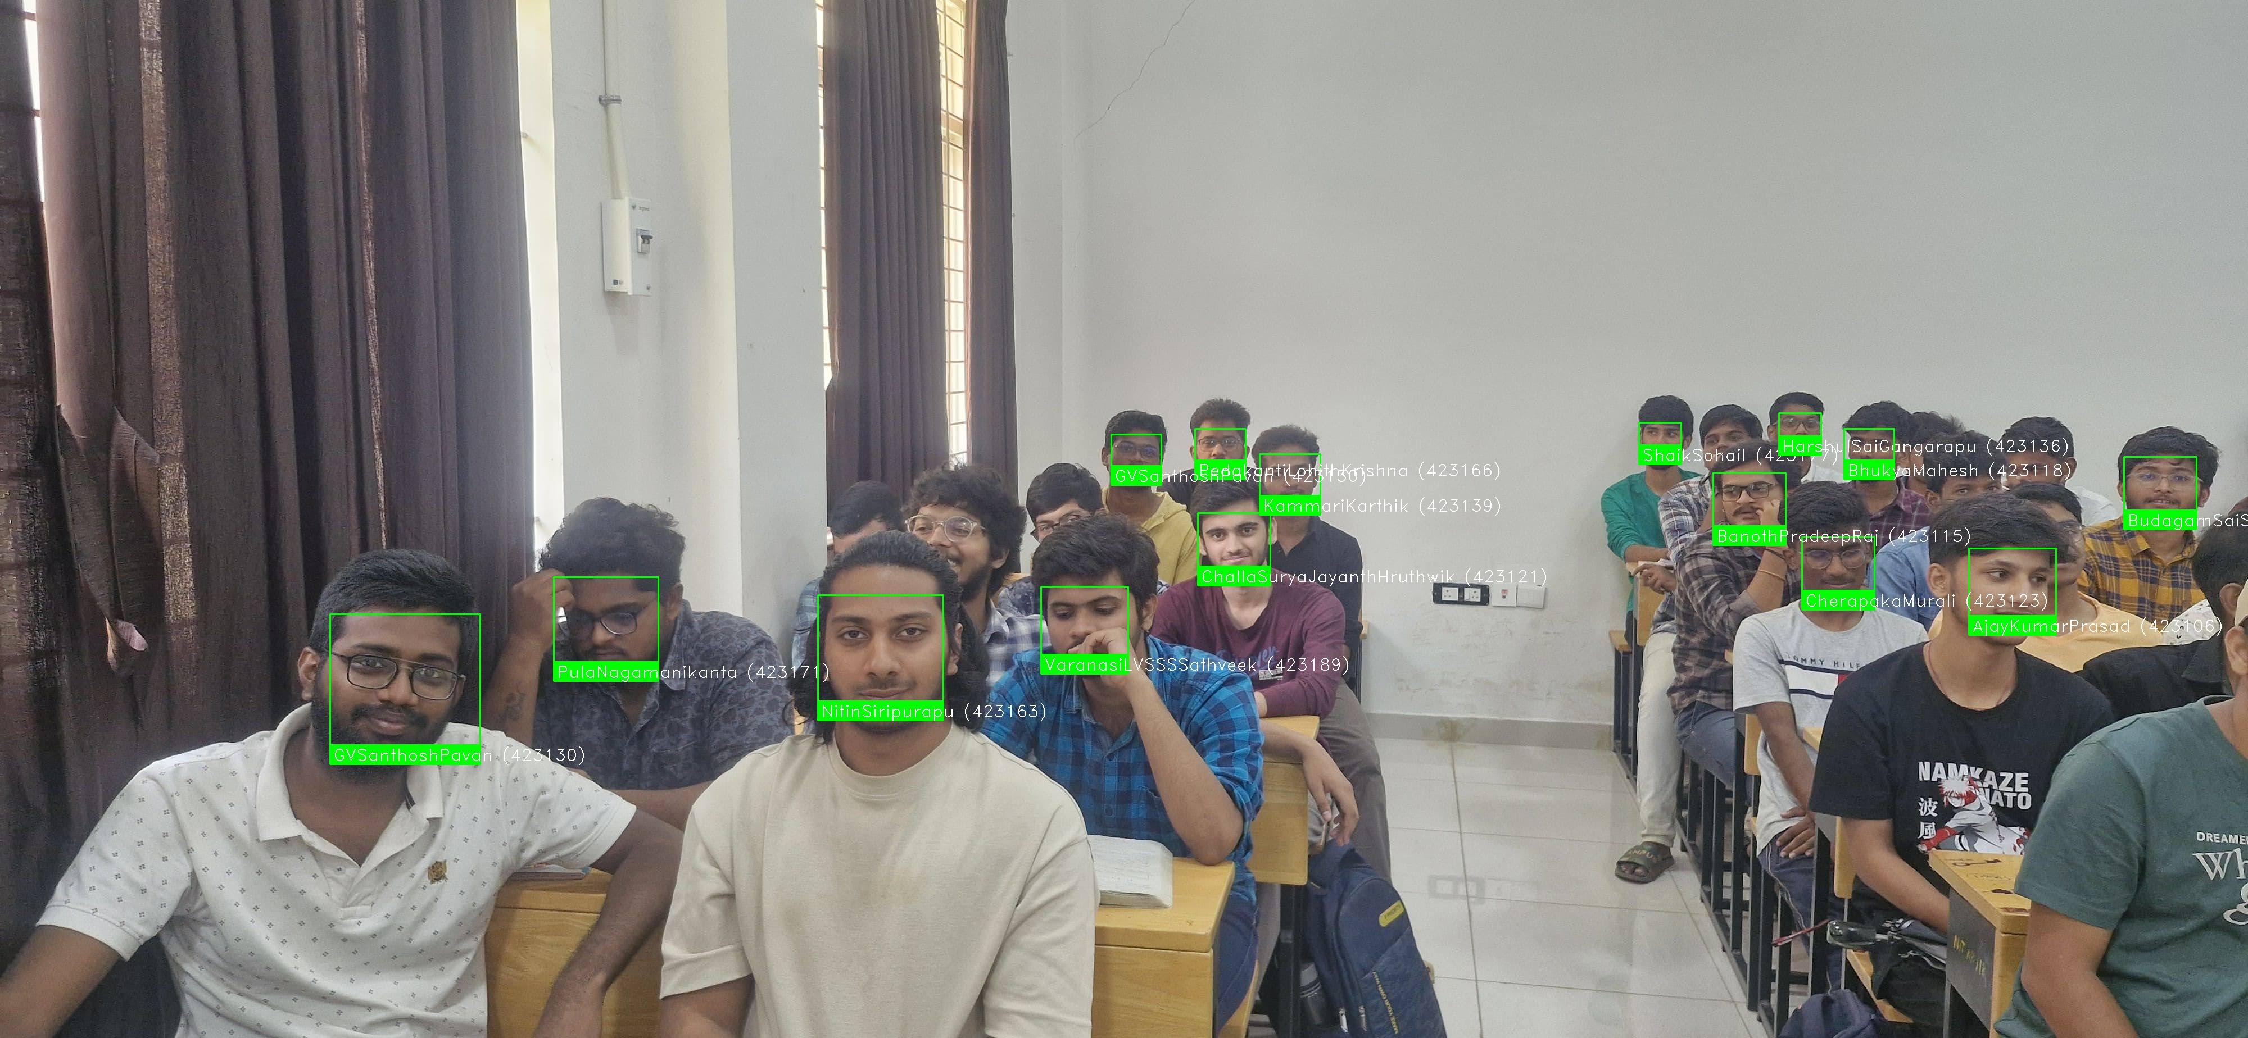
PHOTO-2-RESULT
Precision: 86.67%
Recall: 81.25%
F1-Score: 83.87%
FPIR: 12.50%
FNIR: 6.25%
Rank-1 Accuracy: 81.25%
FMR: 0.2500%
Total Error Rate: 18.75%

Slide 14
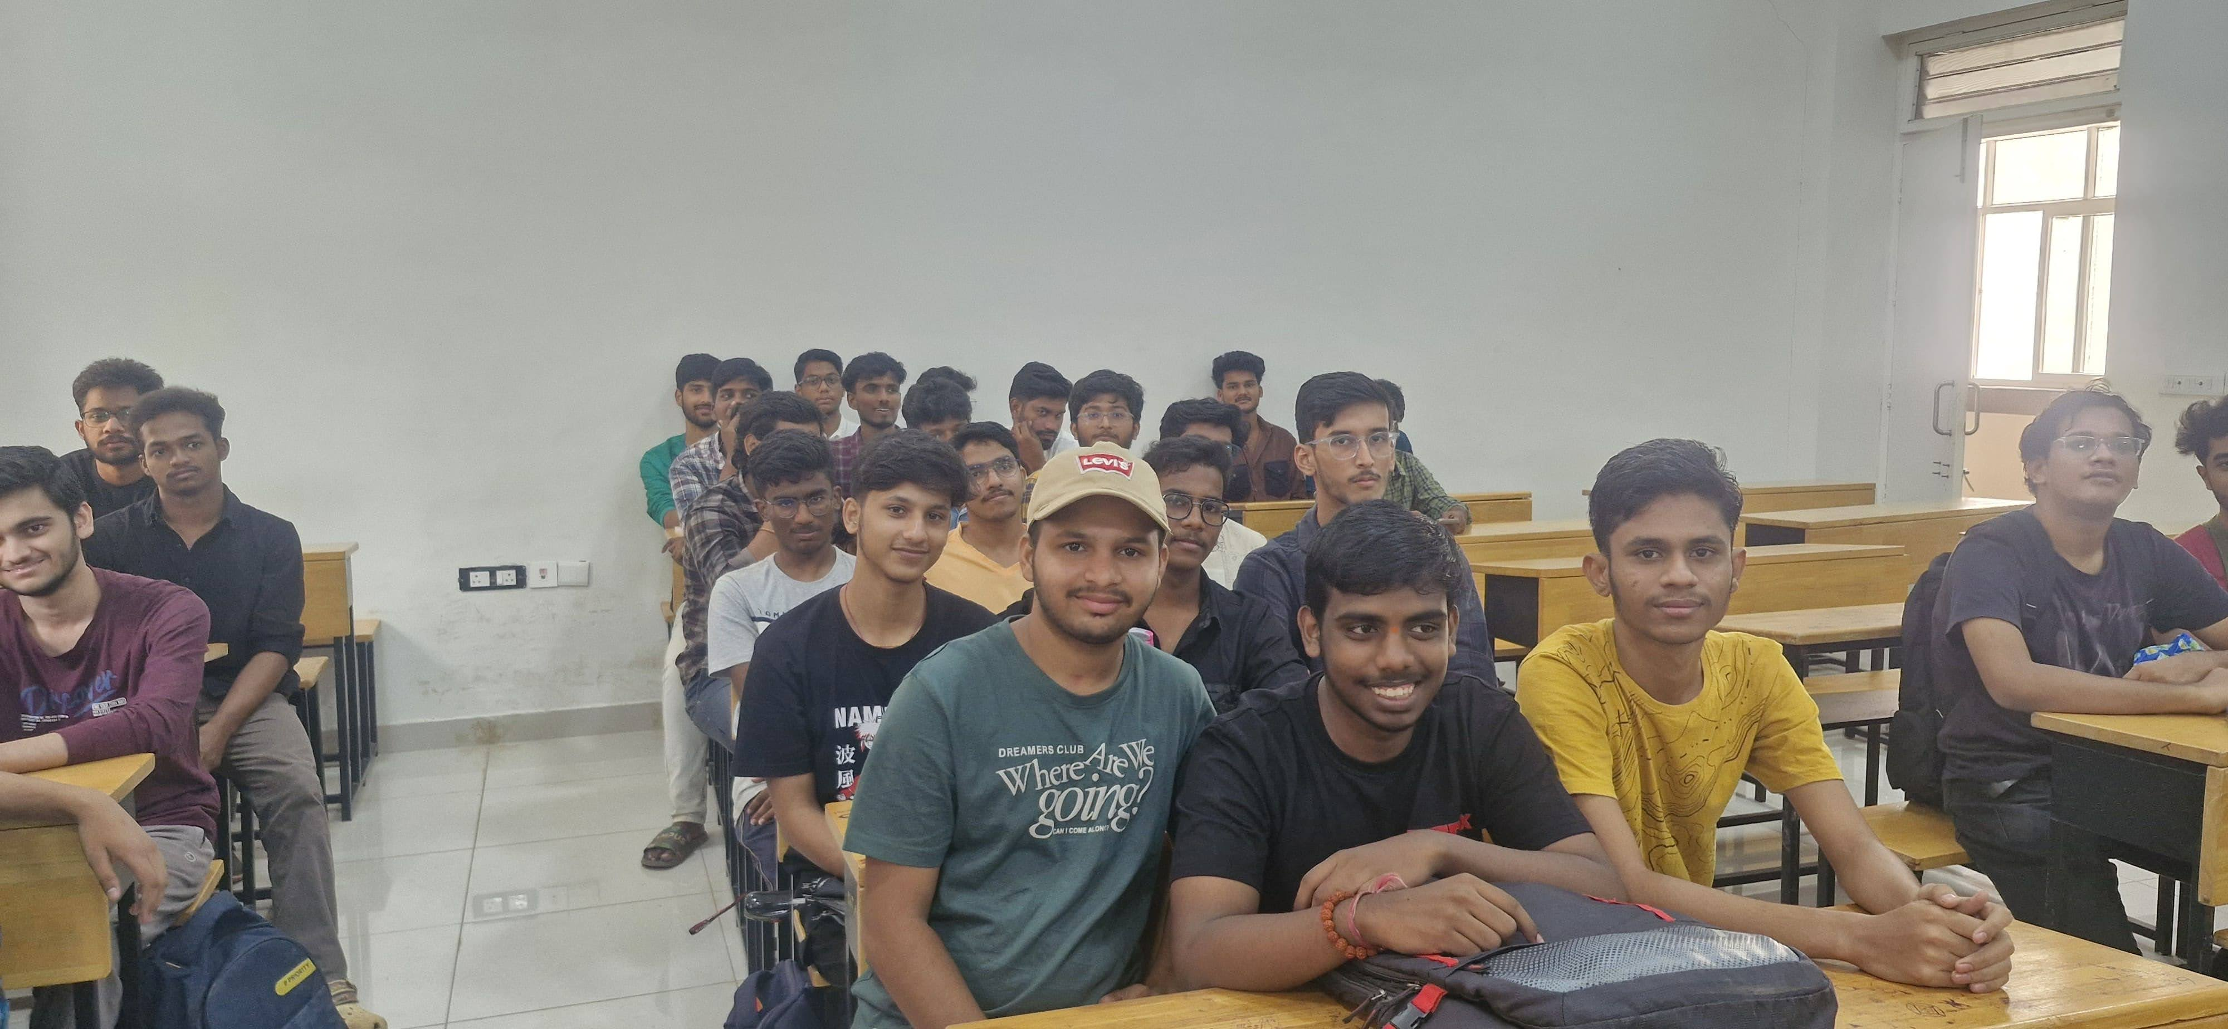
PHOTO-3
TOTAL STUDENTS IN THE PHOTO - 17

Slide 15
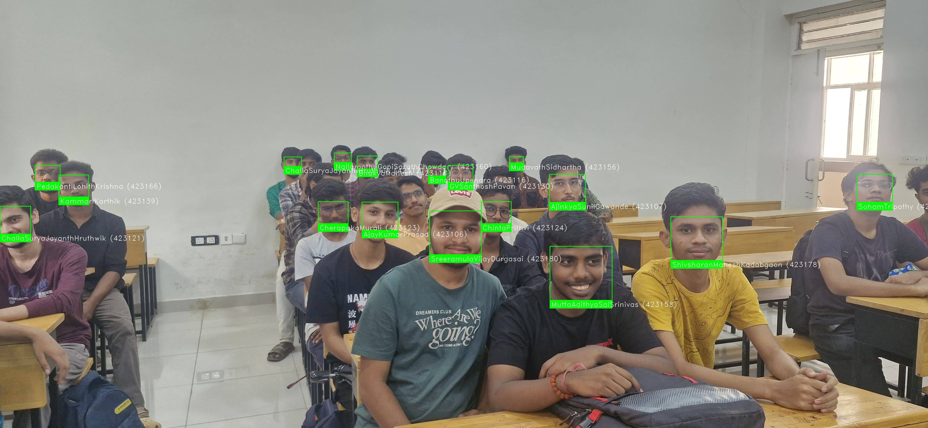
PHOTO-3-RESULT
Precision: 88.24%
Recall: 88.24%
F1-Score: 88.24%
FPIR: 11.76%
FNIR: 5.88%
Rank-1 Accuracy: 88.24%
FMR: 0.2353%
Total Error Rate: 17.65%

Slide 16
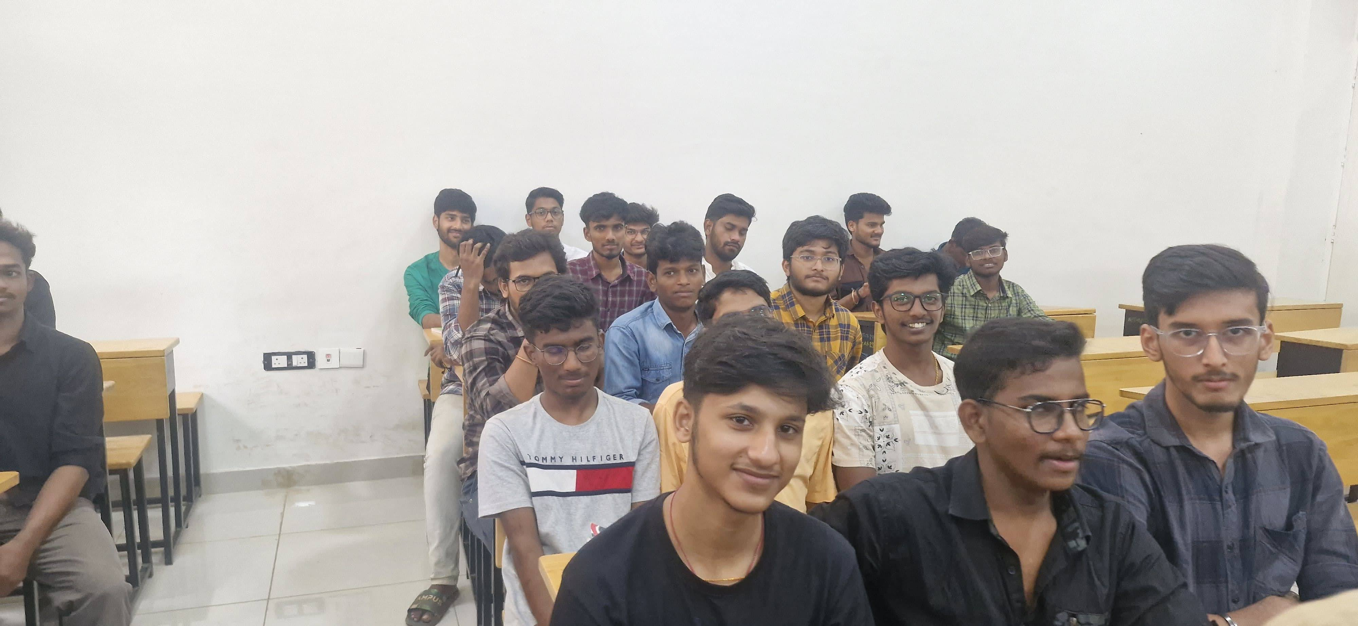
PHOTO-4
TOTAL STUDENTS IN THE PHOTO - 18

Slide 17
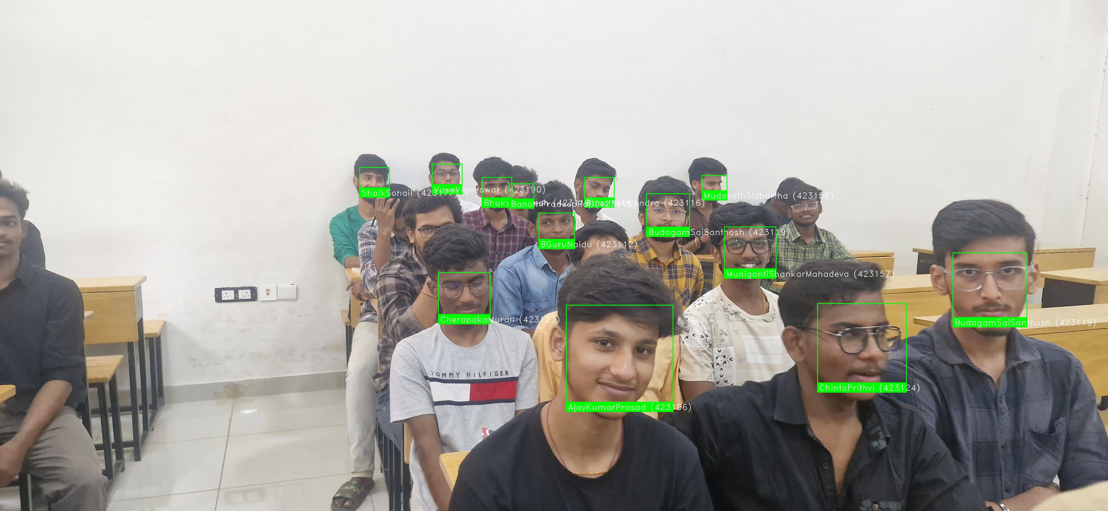
PHOTO-4-RESULT
Precision: 93.75%
Recall: 88.24%
F1-Score: 90.91%
FPIR: 5.88%
FNIR: 5.88%
Rank-1 Accuracy: 88.24%
FMR: 0.1176%
Total Error Rate: 11.76%

Slide 18
COMPARISONS OF OUR MODEL(FACE RECOGNITION LIBRARY-DLIB) VS SOTA MODELS
Factor | Your System | SOTA Models
Face Detection | Basic HOG/CNN, struggles with occlusion/pose | MTCNN(MultiTaskCascaded)/RetinaFace, robust to pose/occlusion
Recognition Model | ResNet (small dataset, less robust) | Deep CNNs (FaceNet, ArcFace, VGGFace2)
Threshold Tuning | Default/fixed threshold | EER(Equal Error Rate) optimized for dataset
Performance | Good for easy cases, poor for real-world | Consistently high, even in difficult cases

Slide 19
COMPARISONS OF OUR MODEL(FACE RECOGNITION LIBRARY-DLIB) VS SOTA MODELS METRICS
Metric | Your System (Range) | SOTA (FaceNet/VGGFace2) | Gap Analysis
FNIR | 5.88%–15% | <1% | High missed enrollments.
FPIR | 5.88%–15% | 0.1–1% | 5× higher false matches.
Precision | 82.35%–93.75% | >99% | Moderate false positives.
Total Error Rate | 11.76%–30% | <2% | Significant room for improvement

Slide 20
WEB-APPLICATION
COMPONENTS
Login/Registration – Secure, password-authenticated access for professors and admins.
Dashboard – Centralized overview displaying key statistics and quick navigation to major features.
Student Database – Supports CSV uploads and manual entry for efficient student data management.
Facial Recognition Attendance – Automated attendance marking using face recognition technology.
Attendance Reports – Comprehensive reports with overall percentages and customizable filters for detailed insights.
BACKEND-FLASK
FRONTEND-HTML+CSS+JAVASCRIPT

Slide 21
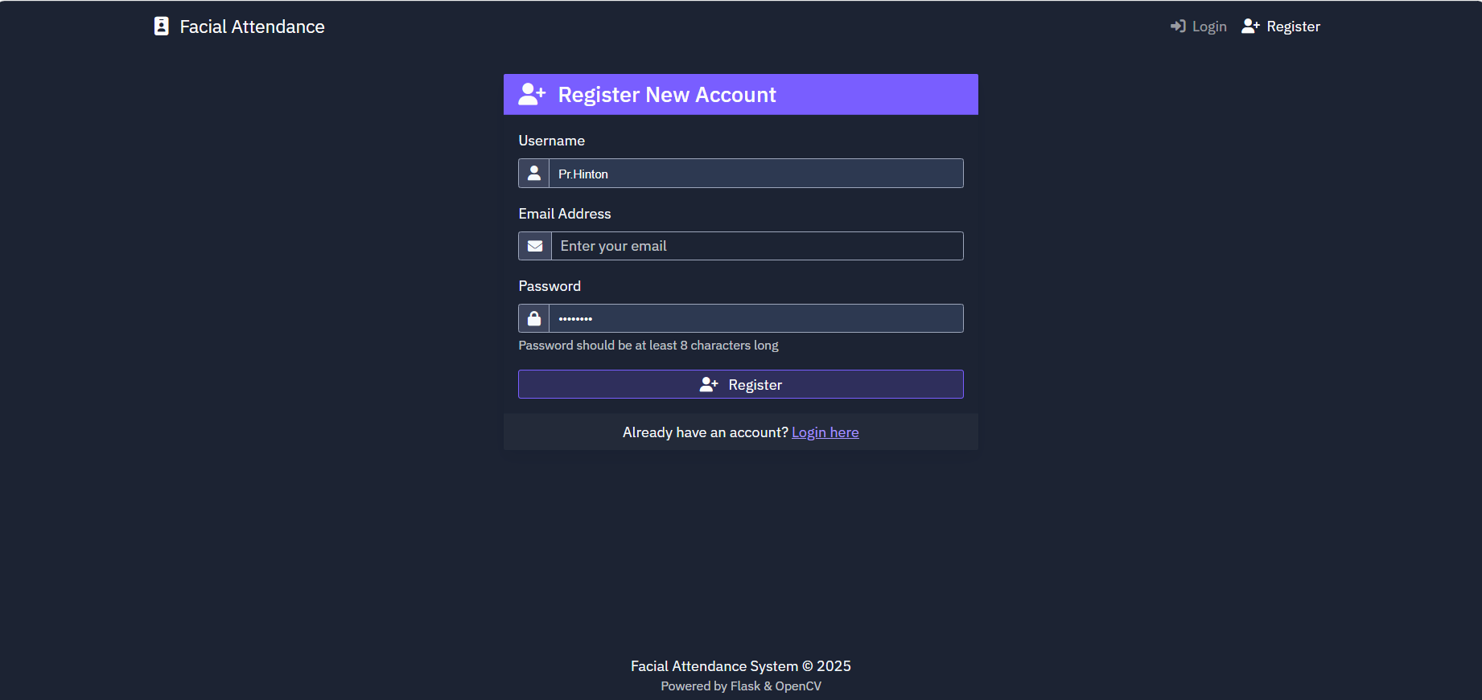
DEMO OF WEB APPLICATION
REGISTRATION

Slide 22
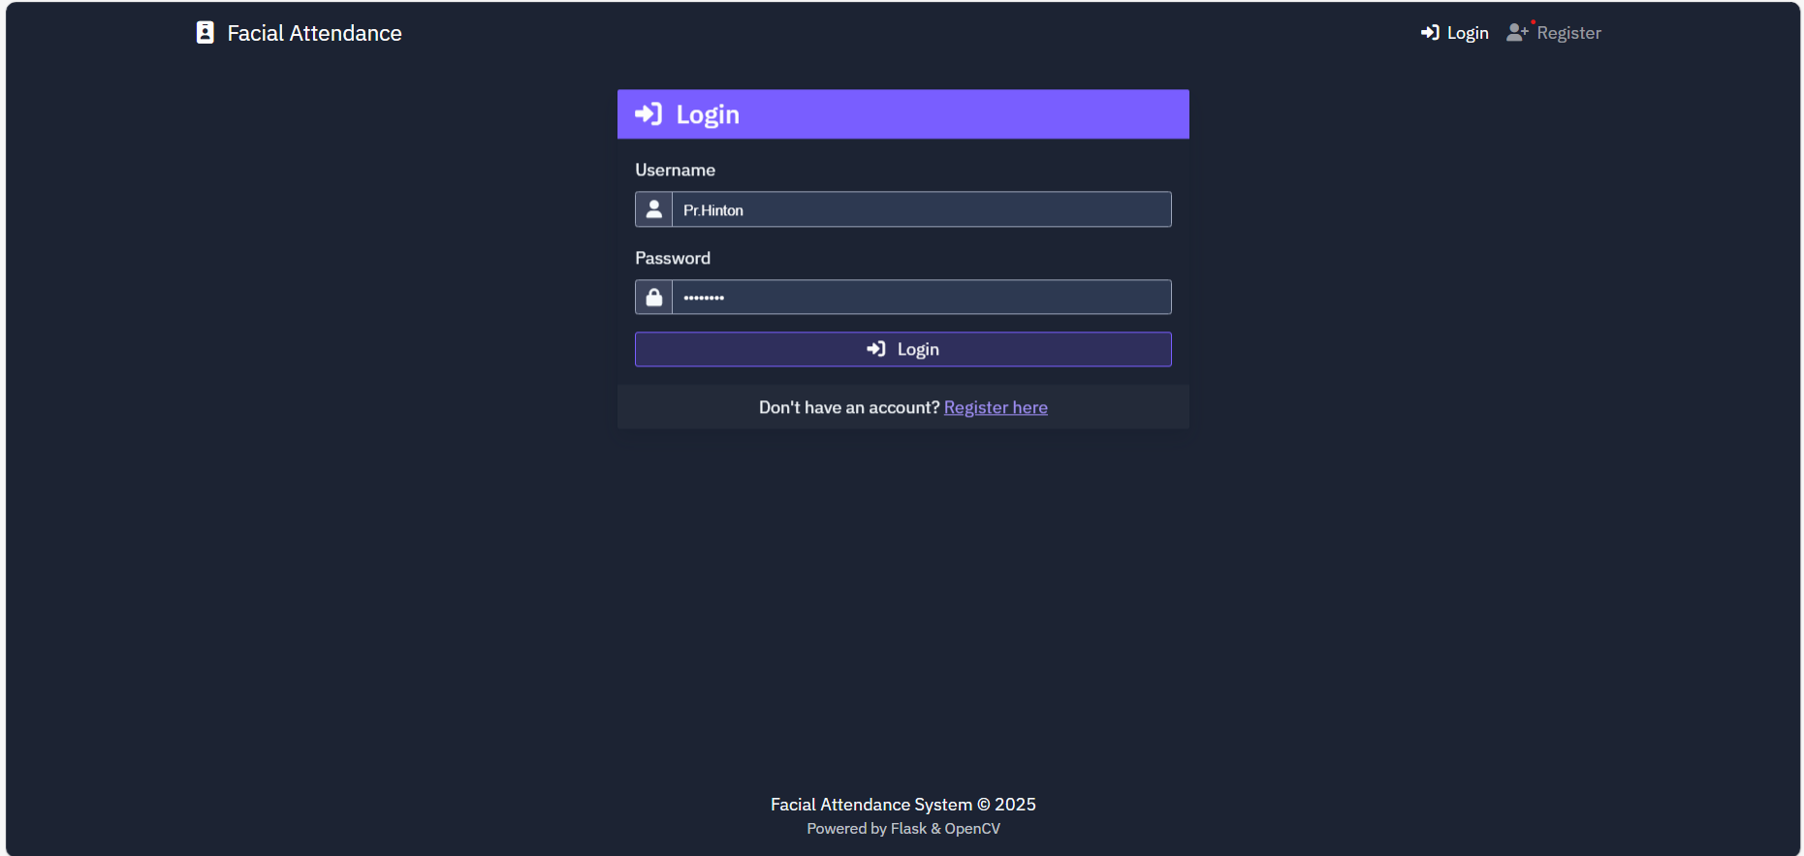
LOGIN

Slide 23
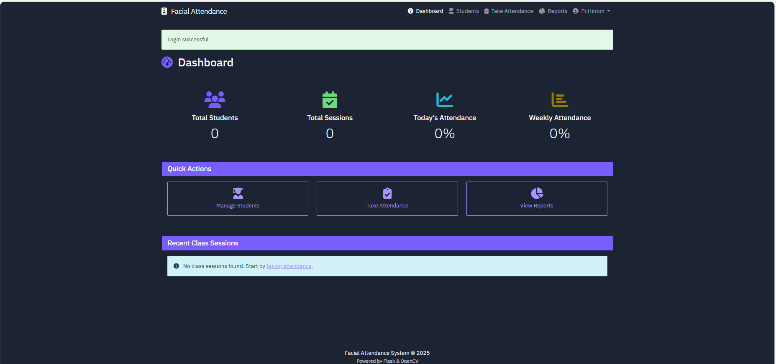
DASHBOARD

Slide 24
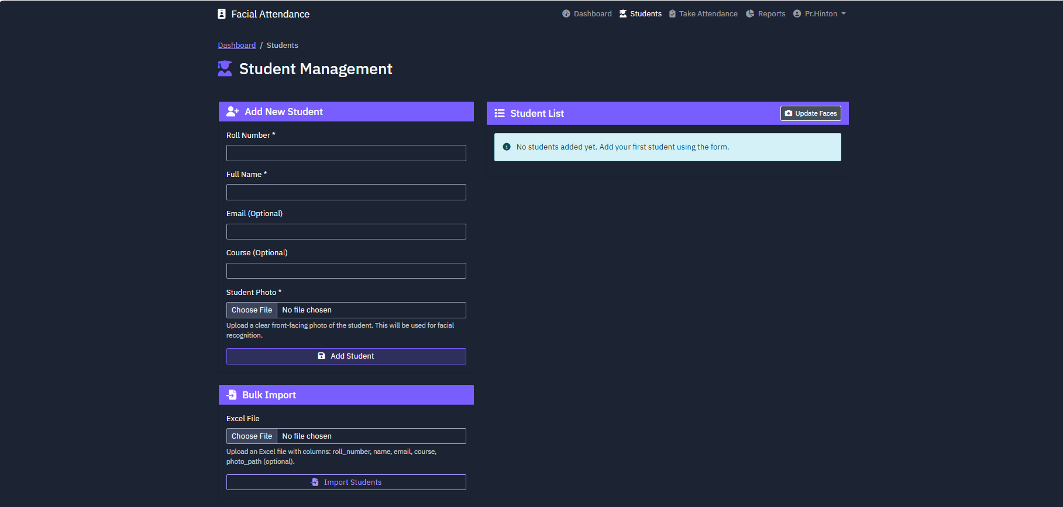
STUDENT LIST

Slide 25
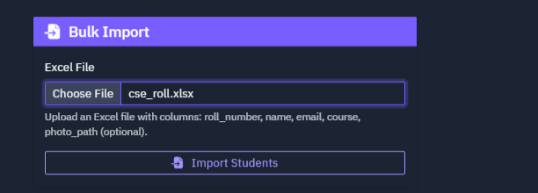
ENTERING STUDENT DATA(VIA CSV FILE)

Slide 26
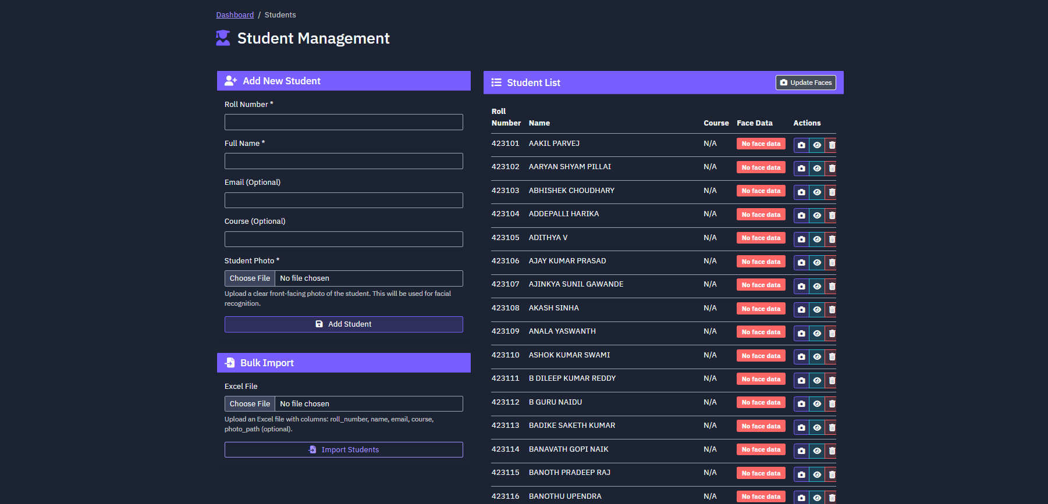
ENTERING STUDENT DATA(VIA CSV FILE)

Slide 27

MANUAL ENTRY OF STUDENT DATA

Slide 28

UPDATE FACE

Slide 29
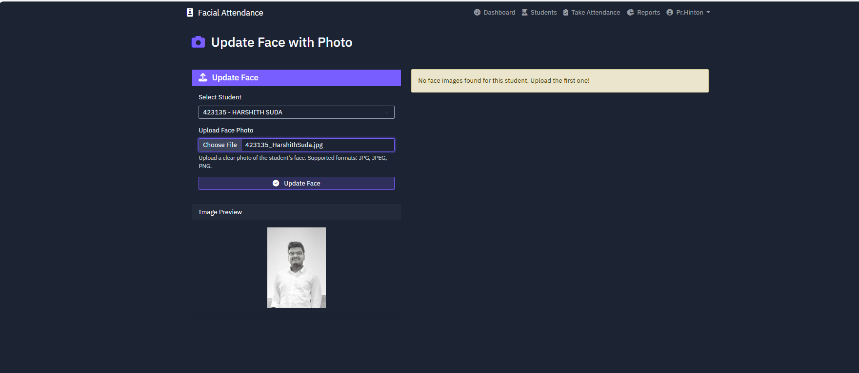
UPDATE FACE(AFTER UPLOADING DATA)

Slide 30

UPDATE FACE(FROM ENTIRE LIST)

Slide 31
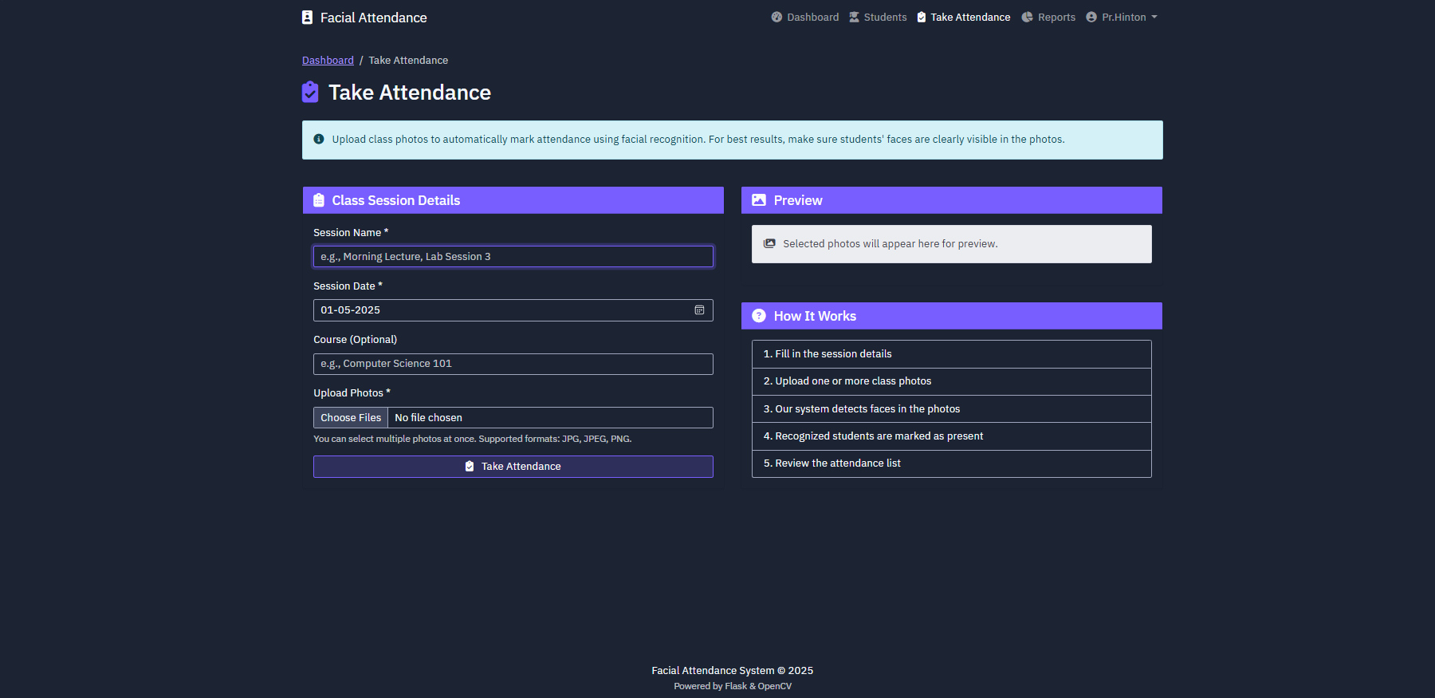
TAKE ATTENDANCE

Slide 32
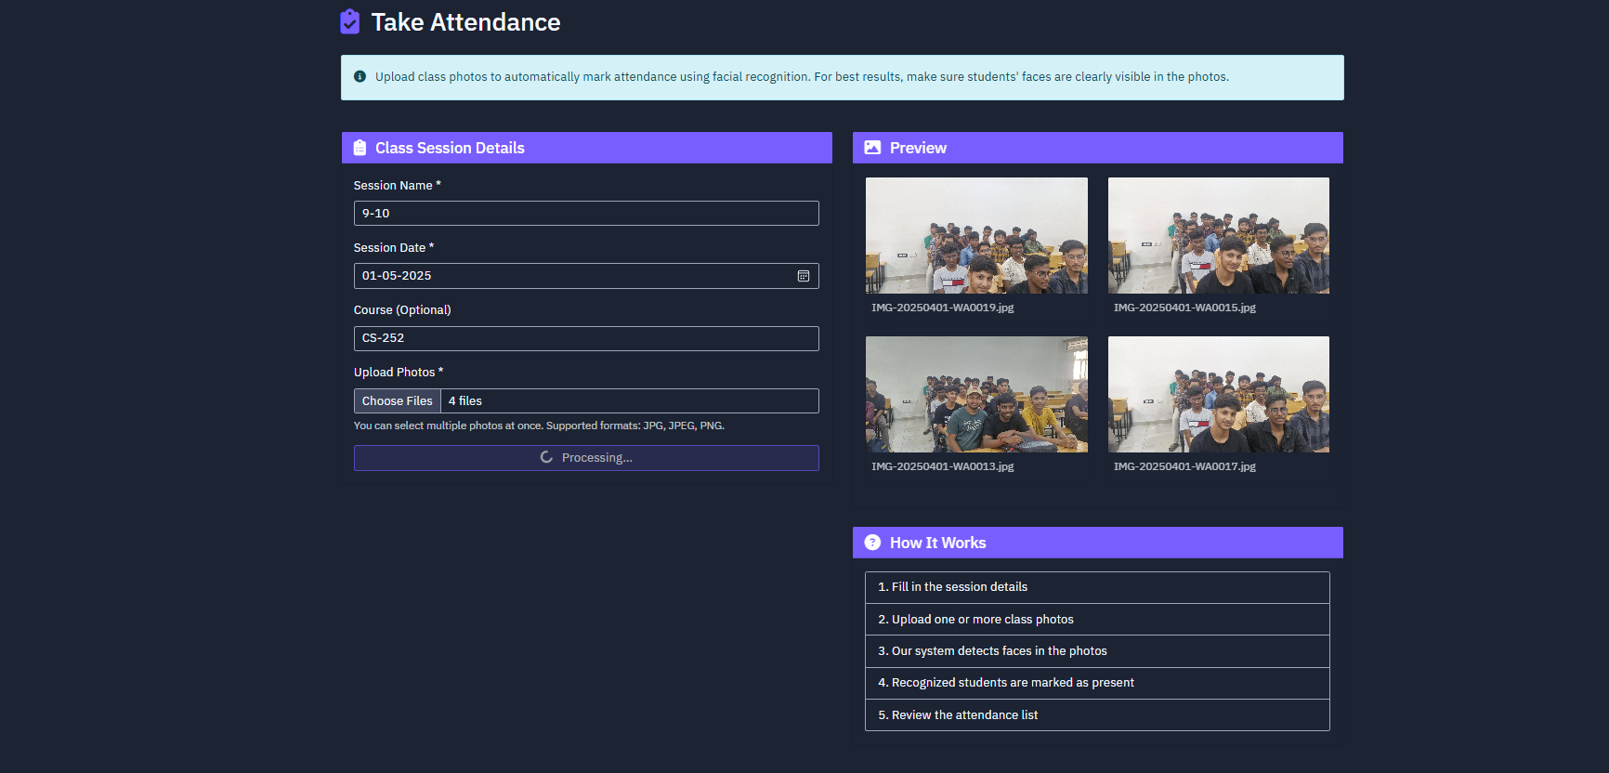
TAKE ATTENDANCE(PRE PROCESSING)

Slide 33
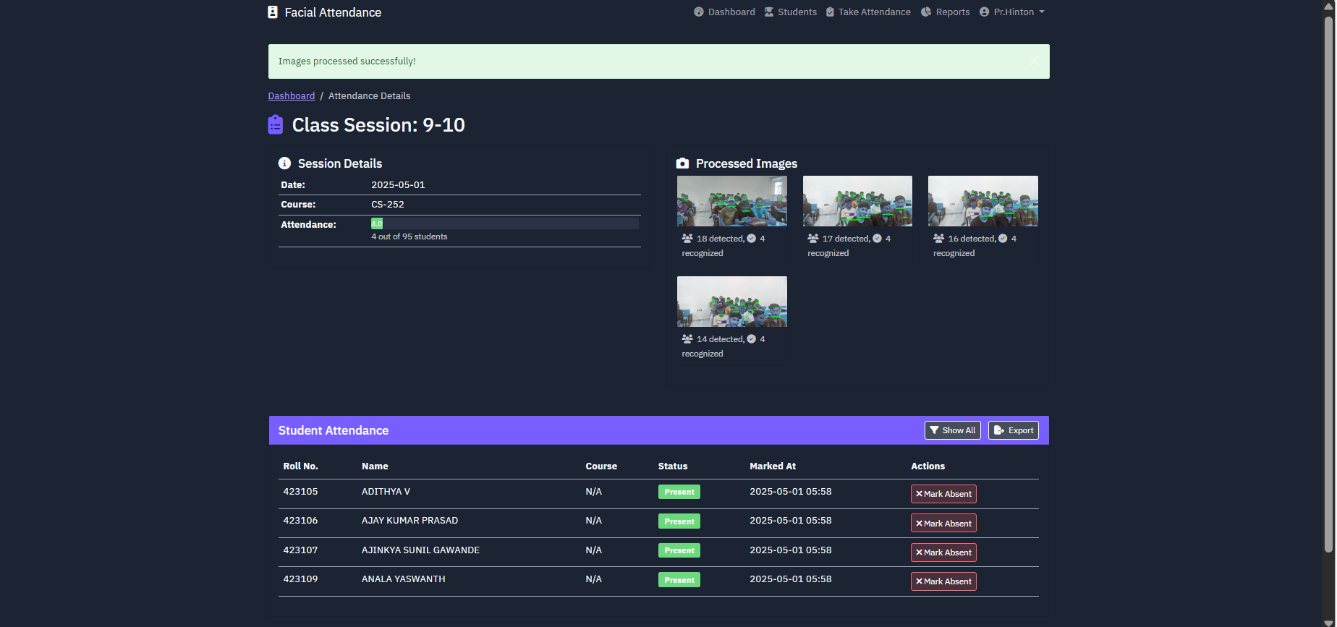
TAKE ATTENDANCE(POST PROCESSING)

Slide 34
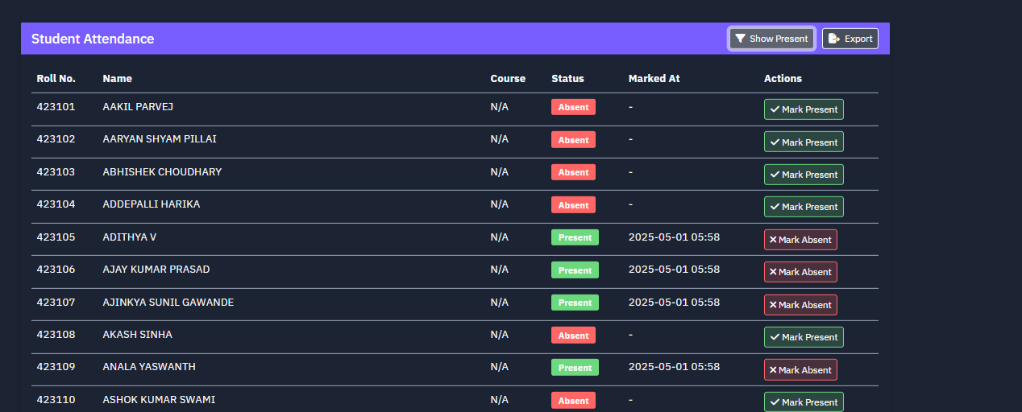
MANUAL MARKING OF ATTENDANCE

Slide 35
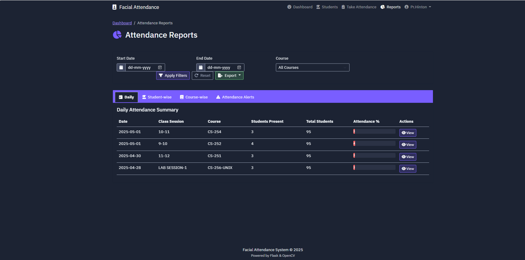
ATTENDANCE REPORTS

Slide 36
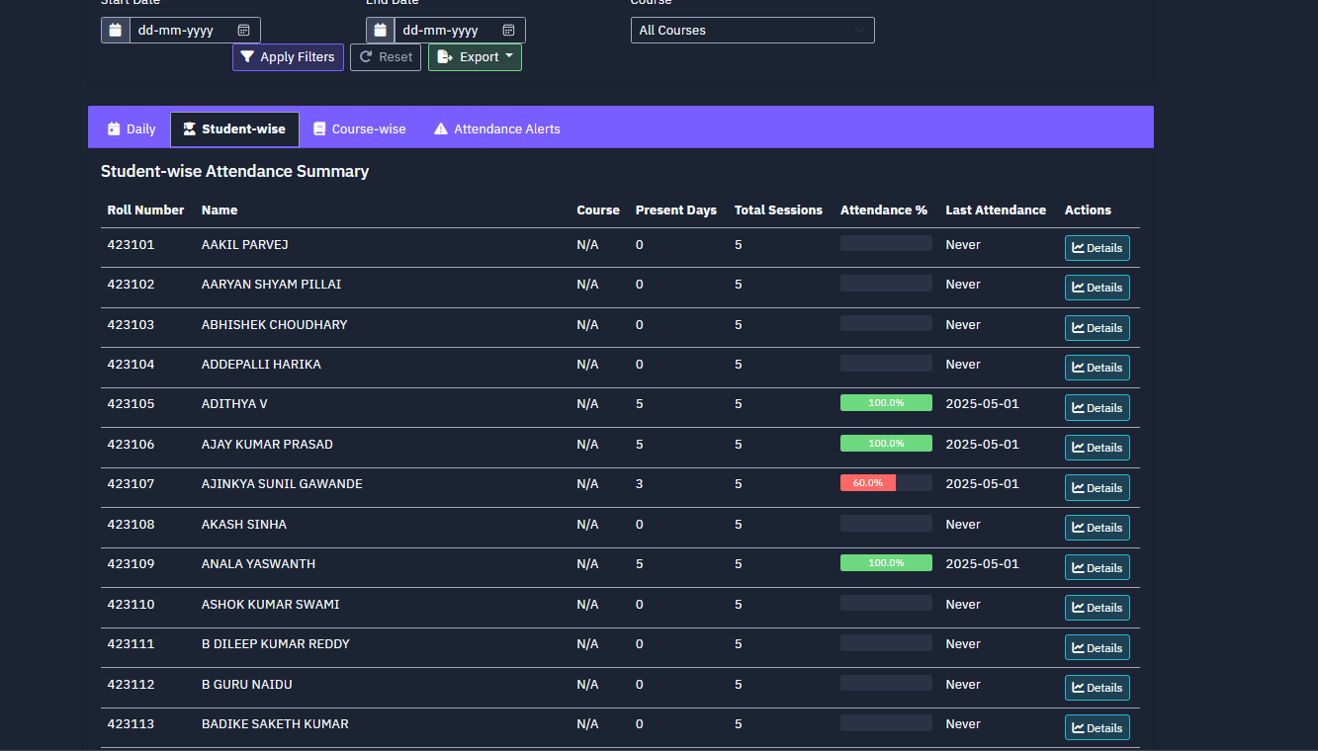
ATTENDANCE REPORTS(STUDENT WISE)

Slide 37
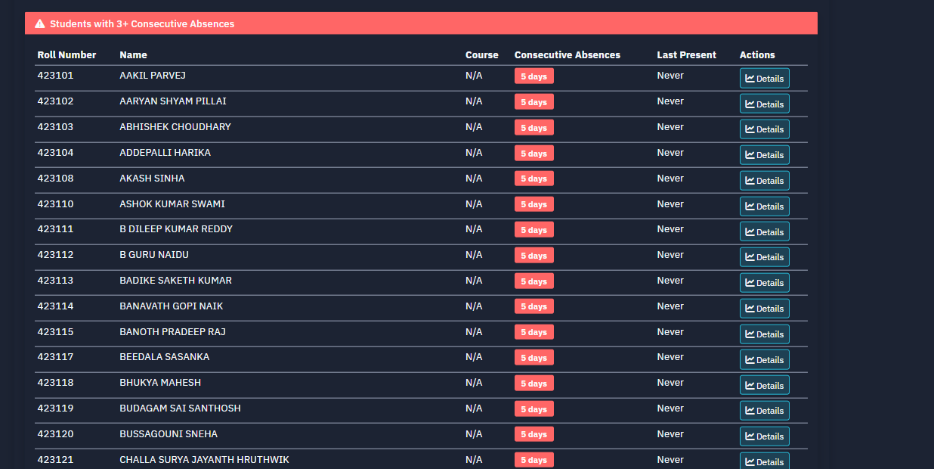
ATTENDANCE REPORTS(CUSTOM NOTIFICATIONS-3 CONSECUTIVE CLASSES)

Slide 38
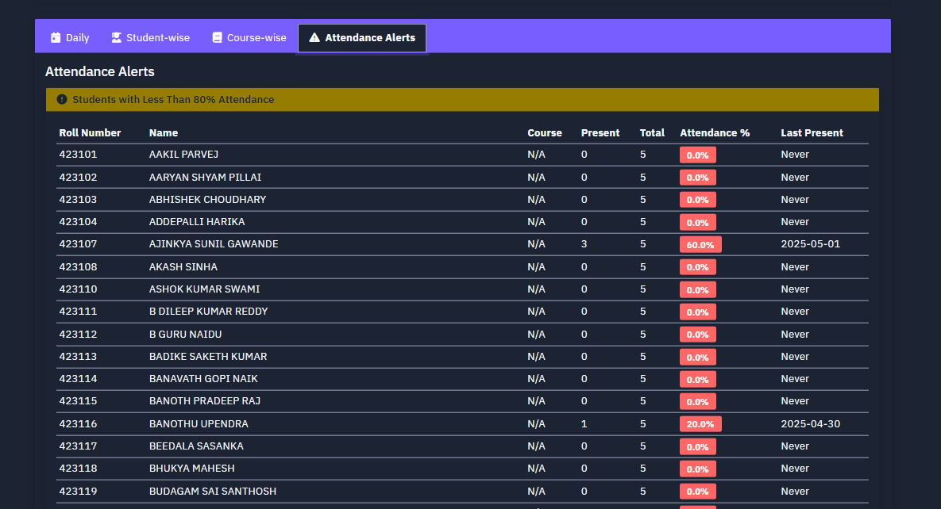
ATTENDANCE REPORTS(CUSTOM NOTIFICATIONS-LESS THAN 80)

Slide 39
REFERENCES
[1] OpenCV Docs, “Face Recognition with OpenCV,” 2024. [Online]. Available: https://docs.opencv.org/4.x/da/d60/tutorial_face_main.html [2] S. Kumar and G. V. R. Sai Lavanya, “Face Recognition Using OpenCV with Deep Learning,” in ICDSMLA 2019, Springer, 2020. [Online]. Available: https://doi.org/10.1007/978-981-15-1420-3_122 [3] R. T. H. Hasan and A. B. Sallow, “Face Detection and Recognition Using OpenCV,” Journal of Soft Computing and Data Mining, vol. 2, no. 2, pp. 86–97, 2021. [Online]. Available: https://publisher.uthm.edu.my/ojs/index.php/jscdm/article/view/8791

Slide 40
THANK YOU

